Slide 1
Name : Raghav Khanna; ID Number : 2018B4A40914P Mentor: Dr. Divyum Sharma, BITS Pilani
Introduction to p-adic numbers

Slide 2
Introduction to the project
In mathematics, the p-adic number system for any prime number p extends the ordinary arithmetic of the rational numbers in a different way than what we are used to.
The extension is achieved by an alternative interpretation of the concept of "closeness" or absolute value. Till now, we have considered the concept of closeness to be a measure of distance, where distance between 2 points x and y is written as |x-y|.
But two p-adic numbers are considered to be close when their difference is divisible by a high power of p: the higher the power, the closer they are. This allows us to study various different concepts like the concept of congruences in a completely different manner than we did in the earlier Number Theory and Algebra 1 courses.
Main focus of this presentation:
Cornerstone Theorems and Lemmas plus a basic outline of their proofs in the theory of p-adic numbers
Important results and concepts which are relevant to my current year

Slide 3
Ostrowski Theorem
Ostrowski Theorem
Every non-trivial absolute value on Q is equivalent to one of the absolute values | |_{p}, where either p is a prime number or p = ∞(usual absolute value).
Outline of the Proof:
We basically show that when | | is Archimedean, it is equal to | |∞, while when | | is Non-Archimedean, it is equal to | |_{p}
For the first part, we show that there exists some n ∈ Z(later extended to Q) such that
|n| = n^{α} where α is a positive real number
For the second part, we prime factorize n and then we show that |p|<1 for some prime p and |q|=1 for other primes q ≠p which will mean that when | | is Non-Archimedean, and hence equal to | |_{p}.

Slide 4
Exploring Qp
Theorem: Q_{p} is a totally disconnected Hausdorff Space
Outline of the Proof:
Totally Disconnected: We show that for an arbitrary element a ∈ Q_{p}, the connected component C_{a} of a is equal to {a}
Hausdorff: We show that Q_{p} is a metric space, and since all metric spaces are Hausdorff, Q_{p} will be Hausdorff

Slide 5
Hensel’s Lemma
Let F(X) = a₀ +a₁X +a₂X²+· · ·+ a_{n}X^{n} be a polynomial whose coefficients are in Z_{p}. Suppose that there exists a p-adic integer α₁ ∈ Z_{p} such that |F(α₁)| < 1 and |F’(α₁)| = 1. Setting, for each n ≥ 1,
α_{n+1} = α_{n} − F(α_{n}) /F’(α_{n})
defines a convergent sequence whose limit α ∈ Z_{p} is the unique p-adic integer
such that |α − α₁| < 1 and F(α) = 0.
Outline of the Proof:
We use a method called Newton Raphson Method to construct a Cauchy sequence α₁,
α₂… whose limit is α.
This method involves first finding an approximate solution and then using that
approximation to find a better solution.

Slide 6
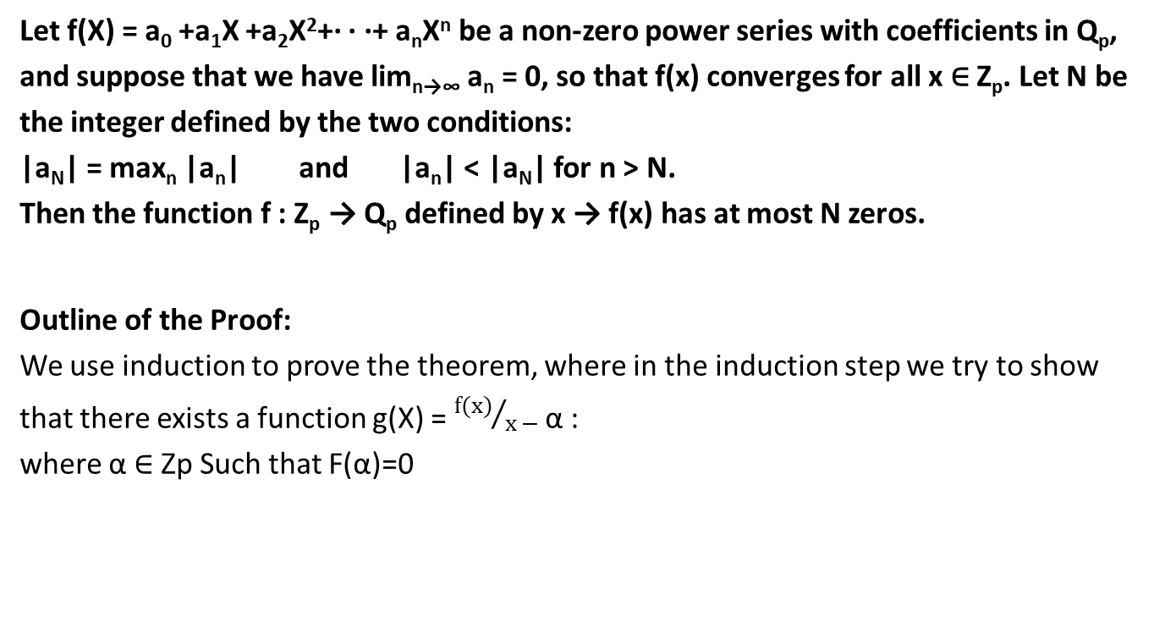
Strassman’s Theorem
Let f(X) = a₀ +a₁X +a₂X²+· · ·+ a_{n}X^{n} be a non-zero power series with coefficients in Q_{p},
and suppose that we have lim_{n→∞} a_{n} = 0, so that f(x) converges for all x ∈ Z_{p}. Let N be
the integer defined by the two conditions:
|a_{N}| = max_{n} |a_{n}| and |a_{n}| < |a_{N}| for n > N.
Then the function f : Z_{p} → Q_{p} defined by x → f(x) has at most N zeros.
Outline of the Proof:
We use induction to prove the theorem, where in the induction step we try to show
that there exists a function g(X) = ${f(x)}/{x −}$ α :
where α ∈ Zp Such that F(α)=0

Slide 7
Other useful theorems
Let f(X) be a power series with coefficients in Q_{p} . If f(x) converges when |x| ≤ r, then the function f : B(0, r) → Q_{p} defined by x→ f(x) is bounded and uniformly continuous.
For any prime p and any positive integer m not divisible by p, there exists a primitive m-th root of unity in Q_{p} if and only if m divides p − 1. (proof from Hensel’s Lemma)
Z₂ with the 2-adic norm is homeomorphic to the middle thirds Cantor set C with the norm it inherits from R.

Slide 8
Thank You

